Slide 1
DSC3108: Big Data Mining and Analytics
Lecture 01 (BSCS_3:1)
Topic: Fundamentals of Big Data
Dr. Daphne Nyachaki Bitalo
Department of Computing & Technology
Faculty of Engineering, Design & Technology
Fri 6th Sept 2024

Slide 2

COURSE OVERVIEW
Big Data
Fundamentals and Mining
Data Analytics
Architectures, storage of data
Data Mining Techniques
Descriptive analytics
Predictive analytics
Notes:
Limited empirical investigation into the challenges encountered by Master's degree students
during the dissertation writing process contributes to difficulties in completing dissertations, resulting in elevated dropout rates and delayed program completion. This study seeks to fill this research gap by examining the specific challenges and solutions.

Slide 3
Lecture Objectives and Learning outcomes
The Objectives of this lecture are :
Understand the characteristics, challenges, and opportunities of big data
Learn about the big data architectures
Learn about big data storage and management.
Understand the principles of data pre-processing.
By the end of this lecture, students should be able to:
Have an understanding of the applications of big data.
Use python libraries to manage and pre-process big data.

Slide 4
Lecture Overview
Introduction to Big Data
Big Data architectures
Data storage and management
Data pre-processing
Hands-on practical

Slide 5


DSC1101-Introduction to Data Science
Lecture 6
Data management

Slide 6
Understanding big data management
Qn. Describe data flow through pipelines
The data pipeline starts with data being extracted, transformed and loaded for storage either on cloud or on-premises storage.
Data flows through the three phases of a data pipeline; ingestion(Extract), transformation and storage(load).

Slide 7
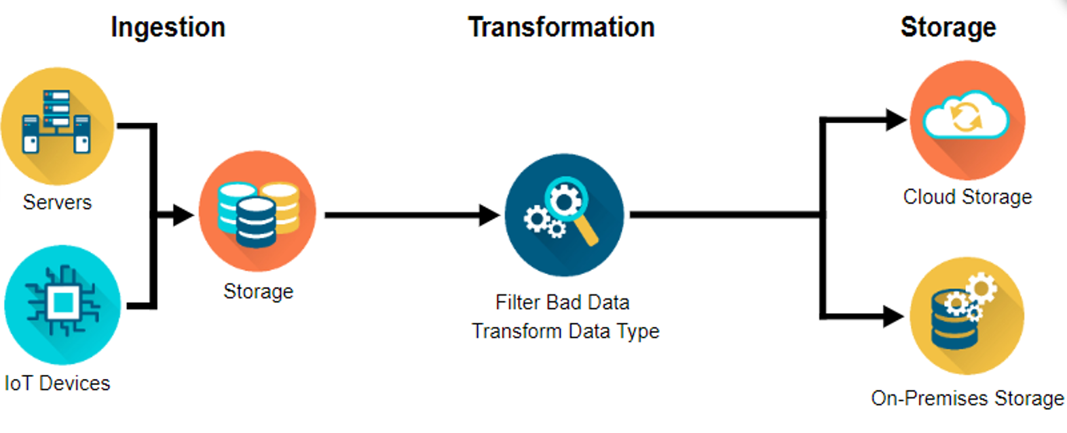
Understanding big data management

Slide 8
Ingestion (Extraction)
Data engineers ingest two primary sources of data;
1. Batches of data from servers or databases (batch ingestion).
An example of batch ingestion is a game company that wants to examine the relationship between subscription renewals and customer support tickets. It could ingest all the related data on a daily or weekly basis. It doesn’t need to access and analyze data immediately after a support ticket is closed or a subscription is renewed.

Slide 9
Ingestion (Extraction)
2. Real-time events happening in the world and streaming from the world of devices (streaming ingestion).
An example of streaming ingestion is when you request a ride from a ride share service. The company combines streams of data (e.g. historical data, real-time traffic data, and location tracking) to make sure you get a ride from the driver who is closest to you at the time.

Slide 10
Transformation
There are two main issues to deal with here;
Data often needs to be cleaned up.
Missing values, dates can be in the wrong format and data quickly gets outdated.
You might have gathered data on individuals who have changed roles or companies. So, all this data needs to be updated.
There might be data outliers that need to be handled as well

Slide 11
Transformation
2. Transforming the data so that its structure aligns with the system needed to allow accurate analyses.
For example;
You might want to figure out your company’s best selling products every month. But the data may only contain each product’s sale date. You would need to transform the data by creating a number of sales per month variable or total monthly sales.

Slide 12
Loading
After transforming data, it needs to be stored in places and forms, making it easy for analysts to run reports on weekly sales and data scientists to deduce insights and create predictive recommendation models.
Data security, or managing data access so that people who should be accessing the data can efficiently, and keeping out people who shouldn’t.
There are two primary locations for businesses to store their data;
1. On-premises
2. In the cloud but often, companies use a hybrid of both.
The term “on-premises” refers to hardware on an organization’s servers and infrastructure - usually physically on site.

Slide 13
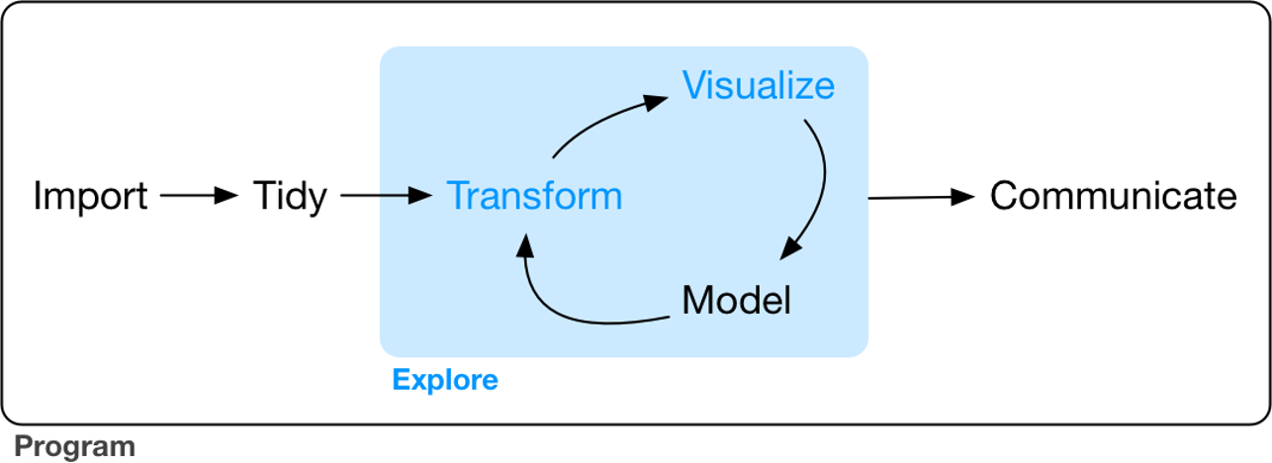
Steps of data exploration
Data exploration is the art of looking at your data, rapidly generating hypotheses, quickly testing them, then repeating again and again and again.

Slide 14
Exploratory Data Analysis (EDA)
An interactive cycle;
1. Generates questions about your data.
2. Searches for answers by visualizing, transforming, and modeling your data.
3. Uses what you learn to refine your questions and/or generate new questions.
There is no rule about which questions you should ask to guide your research.
However, two types of questions will always be useful for making discoveries within your data. You can loosely word these questions as:
1. What type of variation occurs within my variables? (i.e. variability)
2. What type of covariation occurs between my variables? (i.e. central tendency)
All of the above questions generate DESCRIPTIVE and NOT predictive analyses

Slide 15
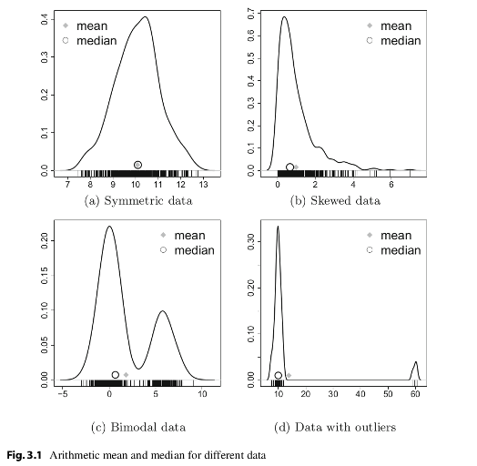
Central tendency
Central tendency is a measure that best summarizes the data and is a measure that is related to the center of the data set.
Described by the statistics Mode, Median and Mean

Slide 16
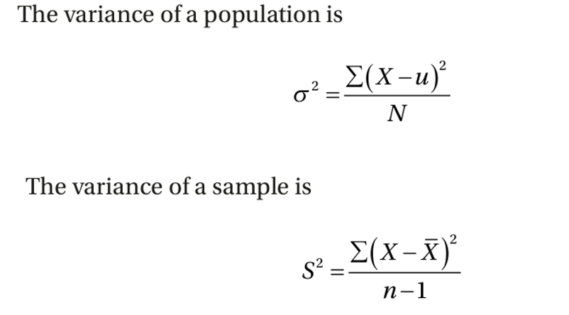
Variability
Measures of variability are the measures of the spread/dispersion of the data.
Described by range, interquartile range, variance, standard deviation, and more
Variance is one of the most important measures in statistics
Covariation- two or more variables vary in a related manner. The best way to discover covariation is to visualize the relation.

Slide 17
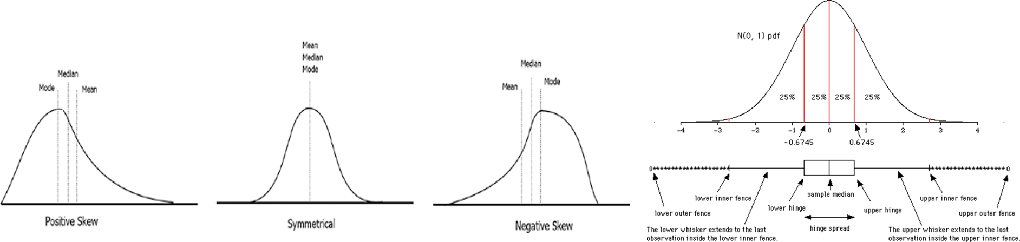
Defining the descriptive statistics
1. Measure of central tendency: mean, median, mode
Measures the “average” or the “middle” of your data. The most commonly used measures include:
•the mean: the average value. It’s sensitive to outliers.
•the median: the middle value. It’s a robust alternative to mean.
•and the mode: the most frequent value

Slide 18
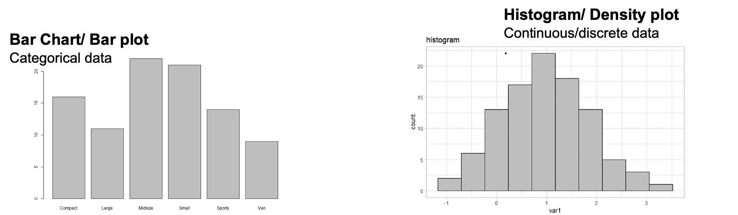
Defining the descriptive statistics
2. Measure of variability
Measures of variability gives how “spread out” the data are.
•Range: minimum & maximum
•Range corresponds to biggest value minus the smallest value. It gives you the full spread of the data.

Slide 19
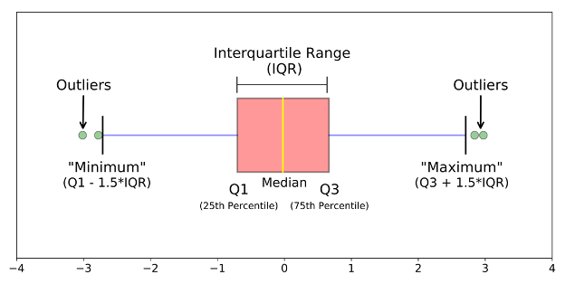
Defining the descriptive statistics
3. Interquartile Range (IQR)
Quartiles divide the data into 4 parts. IQR corresponds to the difference between the first and third quartiles - is sometimes used as a robust alternative to the standard deviation.

Slide 20
Purpose of each descriptive statistic
1. Range. It’s not often used because it’s very sensitive to outliers.
2. IQR. It’s pretty robust to outliers.
3. Variance. It’s completely uninterpretable because it doesn’t use the same units as the data. It’s almost never used
4. Standard deviation. This is the square root of the variance. It’s expressed in the same units as the data. The standard deviation is often used in the situation where the mean is the measure of central tendency.
5. Median. It’s a robust way to impute for missing data, for data with outliers. Used with continuous data that is not normally distributed.
6. Mode. Imputes for missing data that is categorical
7. Mean. Imputes for missing continuous data that is normally distributed

Slide 21
Testing for normal distribution
Rule of thumb:
Many of the statistical tests including correlation, regression, t-test, and analysis of variance (ANOVA) assume some certain characteristics about the data. They require the data to follow a normal distribution or Gaussian distribution. These tests are called parametric tests, because their validity depends on the distribution of the data.

Slide 22
Testing for normal distribution
So the distribution of data has to be testing using the following:
1. Visual inspection [normal plots (histogram), Q-Q plot (quantile-quantile plot)], boxplots)
2. Significance tests. Such as Shapiro-Wilk’s test (samples >3< 5000) and Kolmogorov-Smirnov (K-S) test (samples > 5000)
Data distribution also informs how missing data is handled

Slide 23
Practicum using python
1. Import the provided datasets in to visual studio (“Cassava_Yield_Data.xlsx” and “Bike_Sales.xlsx”)
2. Explore the datasets by identifying the data type of each variable.
3. Which variables are observations and which are samples?
4. Which variables are populations? (This will be guided by the questions you pose)
5. Transform both datasets to handle missing data.
6. Save the transformed datasets as .csv files with your last name.
7. Using the above saved datasets, describe the central tendency of two continuous variables.
8. Generate graphs to show the variability on one continuous variable and one categorical variable.

